Slide 1



The natural defenses of the Immune System
Notes:
Graag wil ik u vertellen welke meerwaarde Raymedy aan uw leven kan toevoegen.

Slide 2


Slide 3
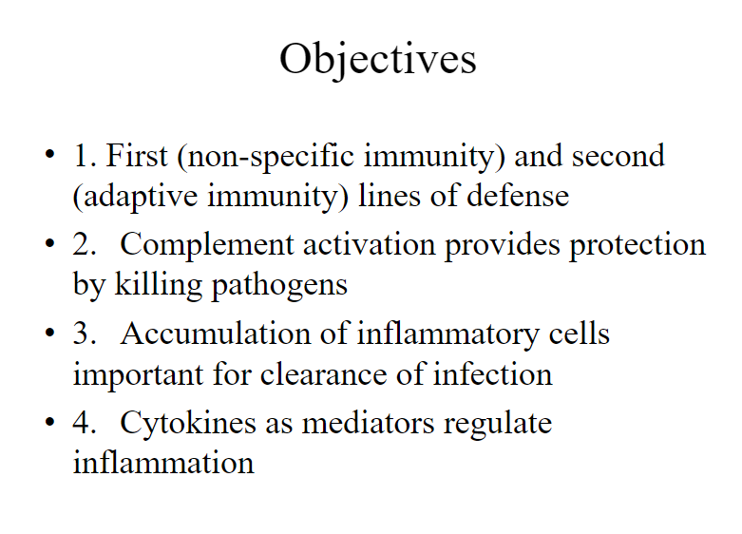

Slide 4
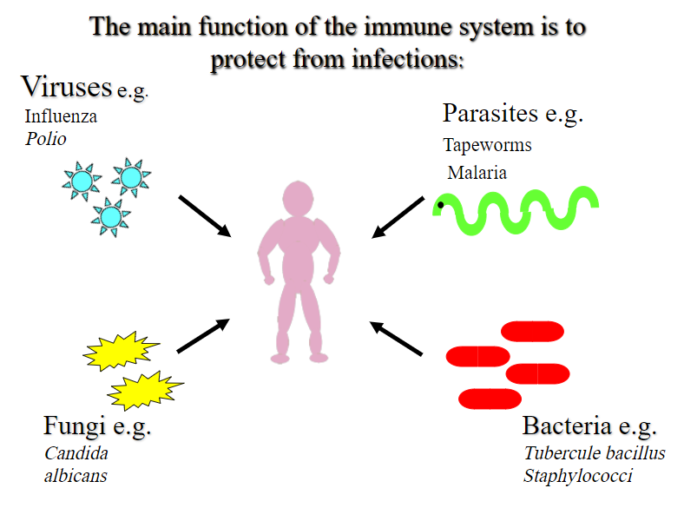

Slide 5
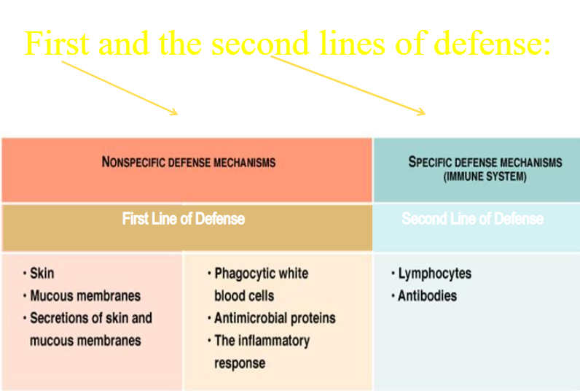

Slide 6
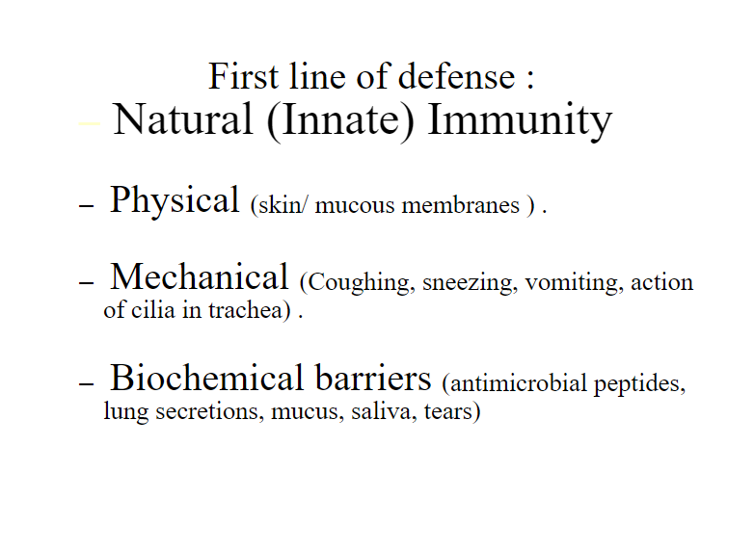

Slide 7
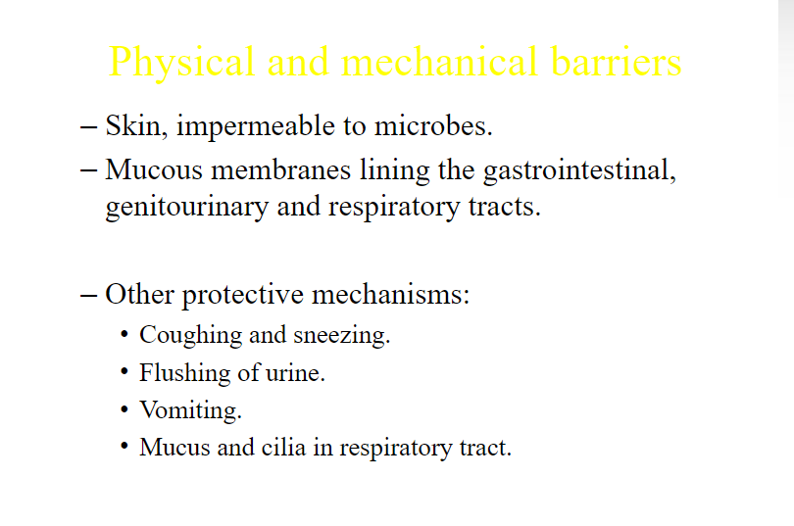

Slide 8
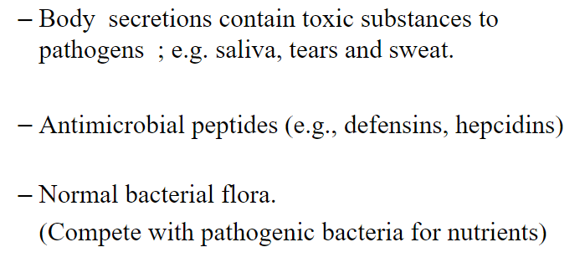
Biochemical barriers

Slide 9
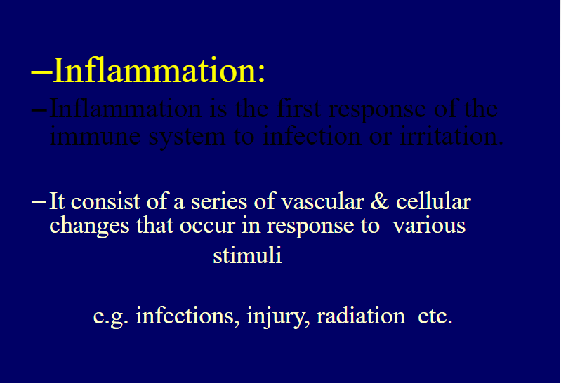
Inflammation
Iinflammation is the first response of the immune sytem to infection or irritation

Slide 10
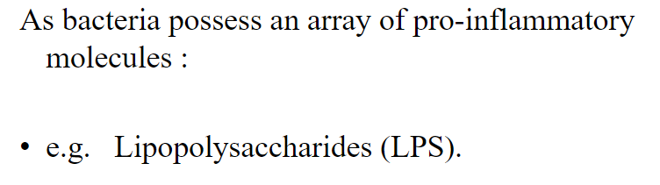
Microbial infections initiate inflammation

Slide 11
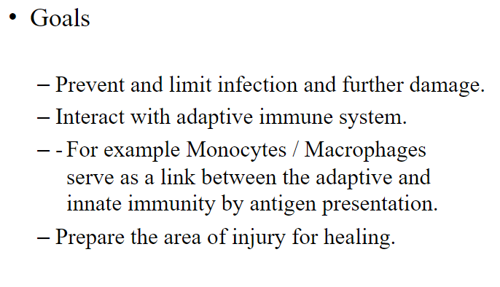
Inflammation

Slide 12
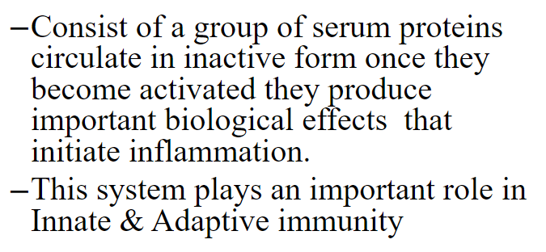
The Complement System

Slide 13
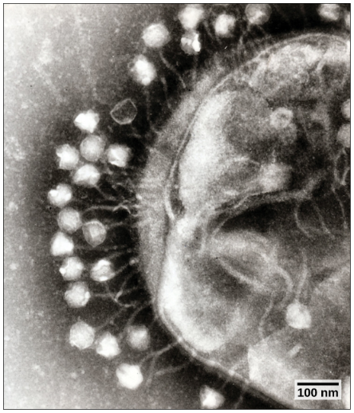
The Complement System
3 pathways of activation:
Classical: requires antigen-antibody binding
C1,C$, C2, C3, C5, C6, C7, C8, C9
Lectin: activated by protein binding mannose groups of bacterial carbohydrates ( C4, C2, C3, C5, C6, C7, C8, C9)
Alternative: activated by bacterial products
( C3, C5, C6, C7, C8, C9)

Slide 14
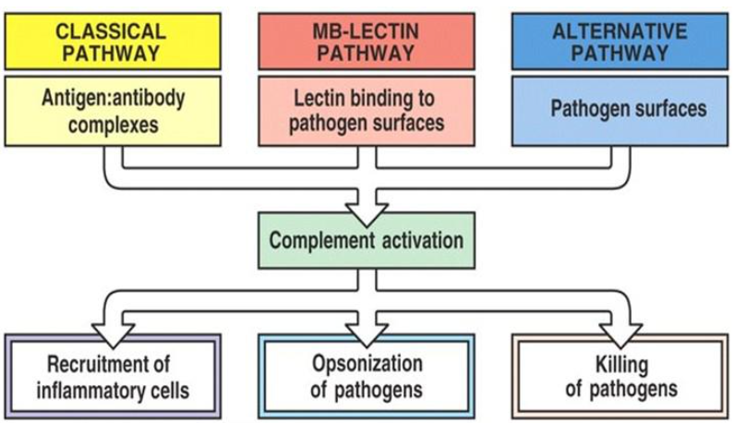

Slide 15
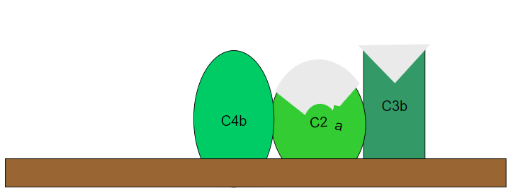
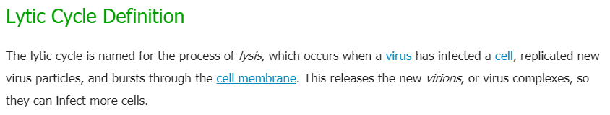
Lytic pathways C5 activation
The lytic cycle (/ˈlɪtɪk/ LIT-ik) is one of the two cycles of viral reproduction (referring to bacterial viruses or bacteriophages), the other being the lysogenic cycle. The lytic cycle results in the destruction of the infected cell and its membrane.

Slide 16
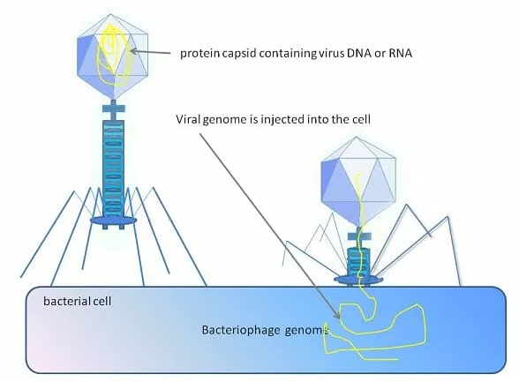
Lytic pathway or Lysogenic pathway

Slide 17
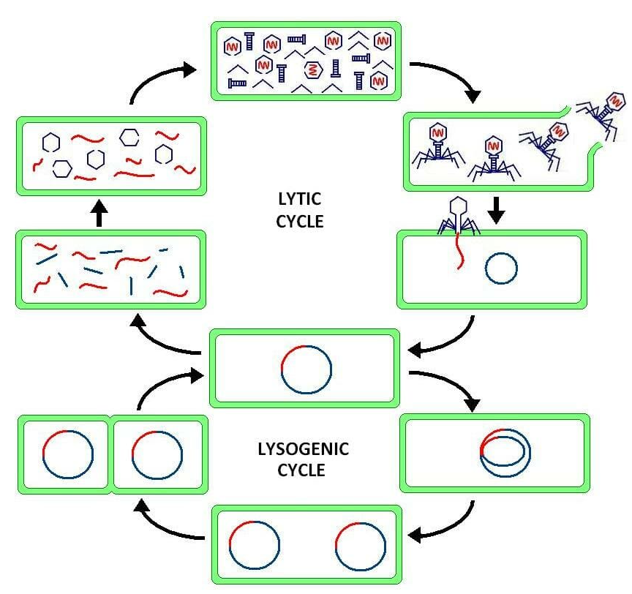
As seen in the graphic above, the lytic cycle is often accompanied by the lysogenic cycle in many bacteria viruses, known as bacteriophages. After the virus injects its DNA or RNA into the host bacteria, the genetic material can enter either the lytic cycle or the lysogenic cycle.
In the lysogenic cycle, the bacteriophage DNA lies practically dormant. However, whenever the bacteria divides, the DNA of the virus is inadvertently copied. In this way, the virus can continue replicating within its host. As long as the bacteria are successful, the virus may remain dormant. At a certain point, conditions may change, and the virus will enter the lytic cycle.

Slide 18
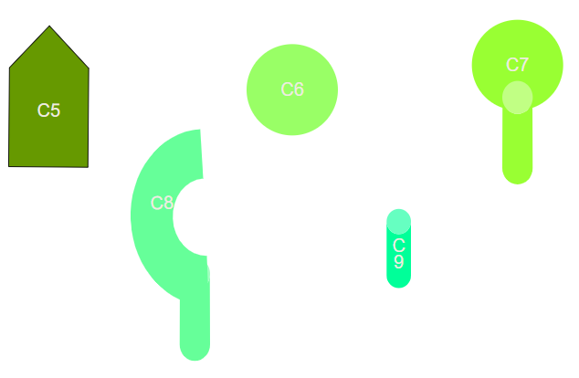
Components of the lytic pathway

Slide 19
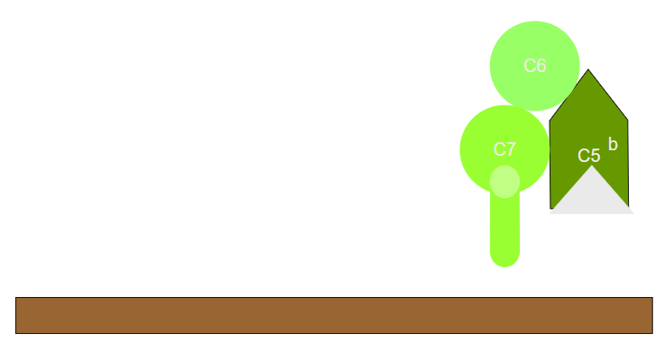
Lytic pathway
Assembly of the lytic complex

Slide 20
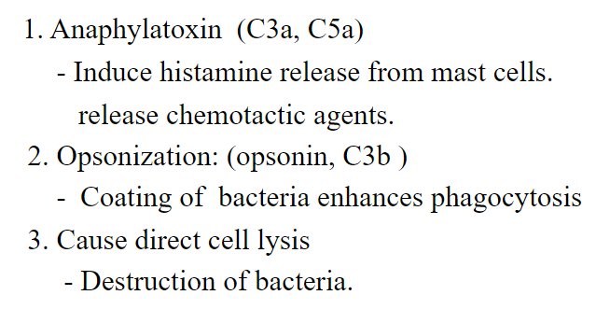
Biological effects of complement activation

Slide 21
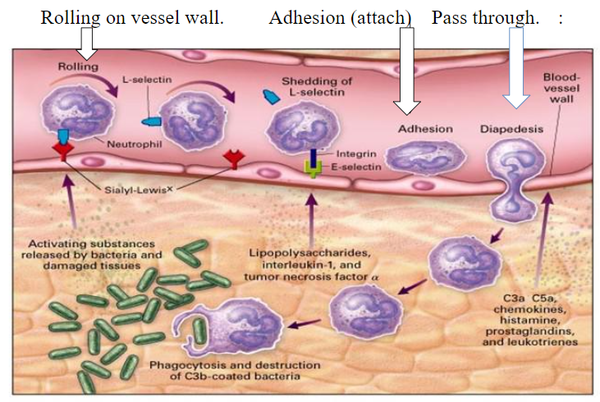
Process of chemotaxis

Slide 22
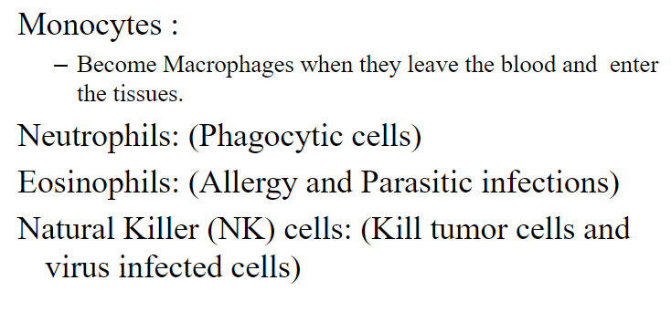
Types of cells attracted to site of infection that mediate inflammation:

Slide 23
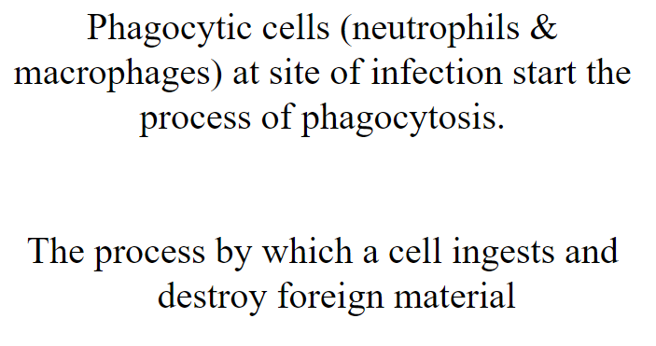

Slide 24
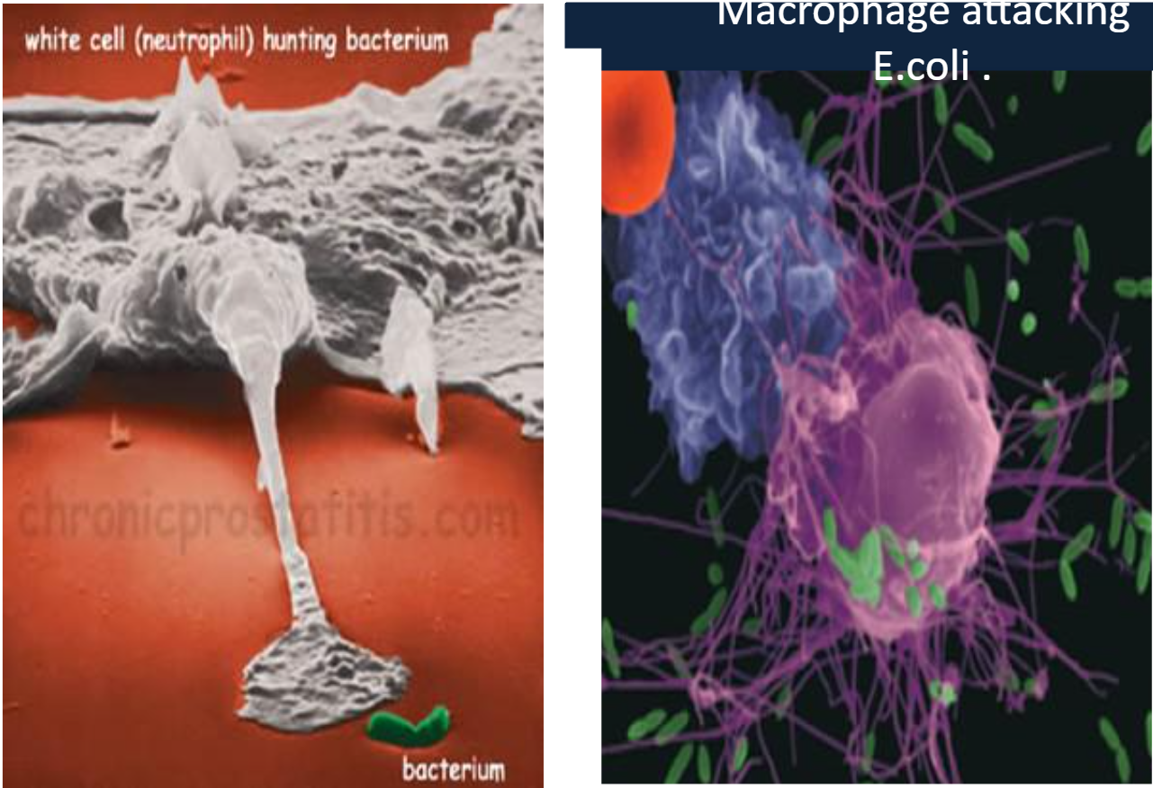

Slide 25
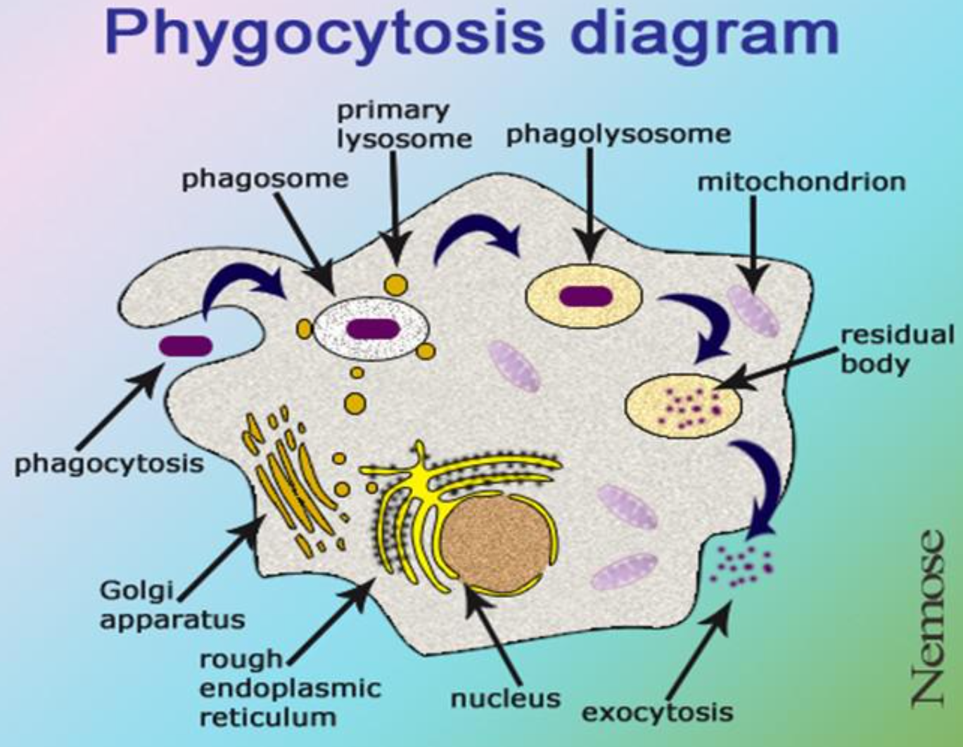

Slide 26
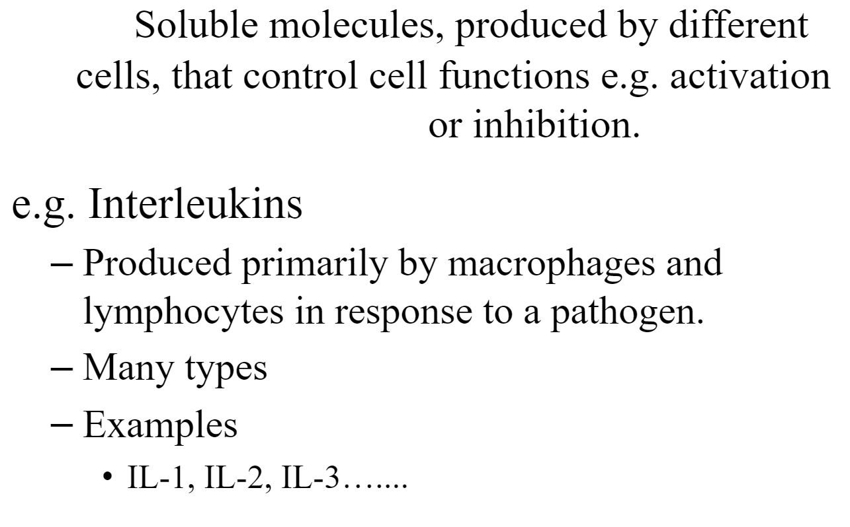
Cytokines

Slide 27
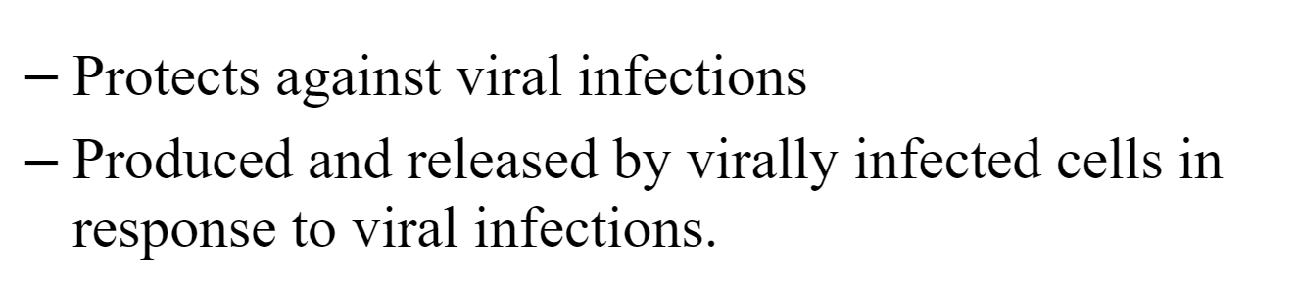
Cytokines
Interferons:

Slide 28
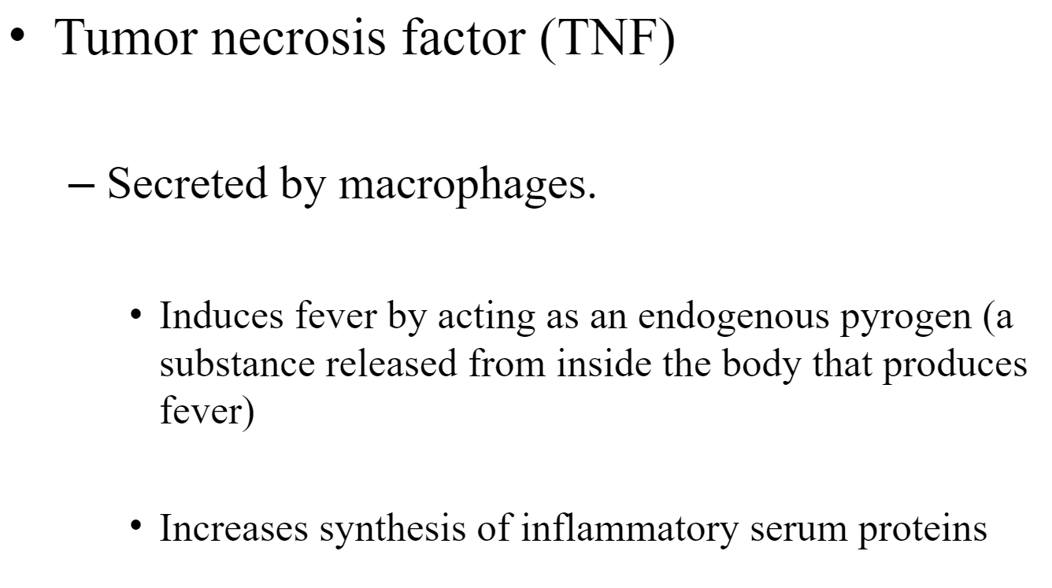
Cytokines

Slide 29
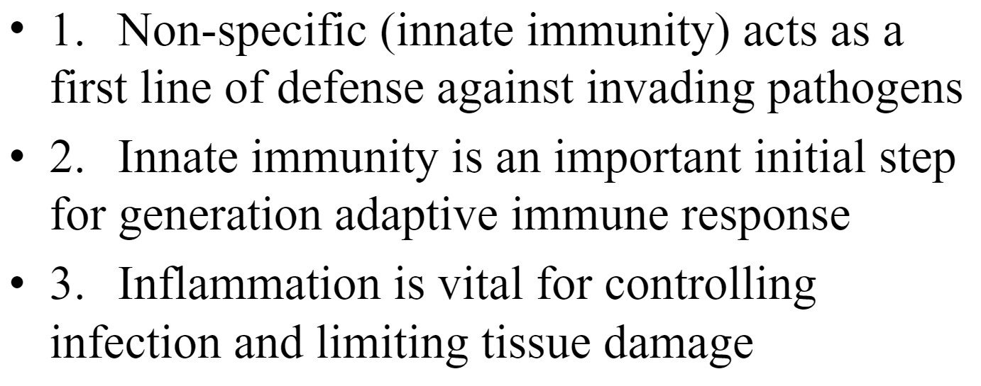
To remember:

