Slide 1



Immunity from antibodies
Notes:
Graag wil ik u vertellen welke meerwaarde Raymedy aan uw leven kan toevoegen.

Slide 2

c

Slide 3
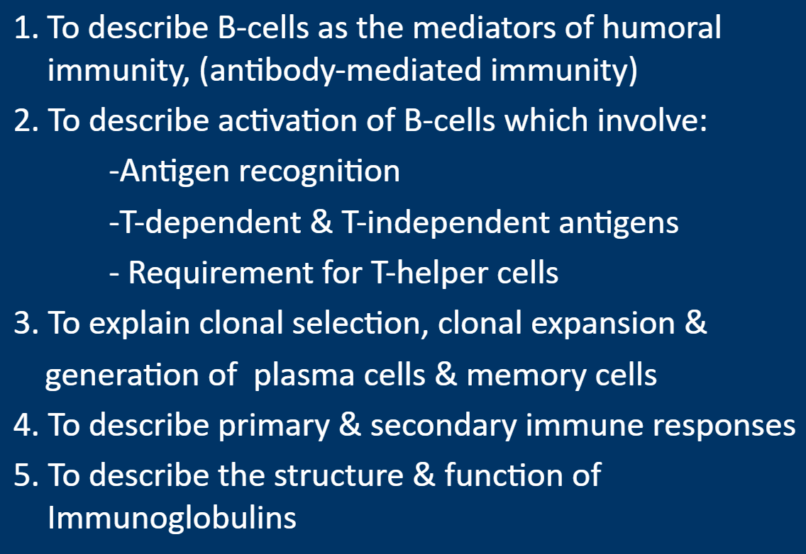
Objectives of this webinar

Slide 4
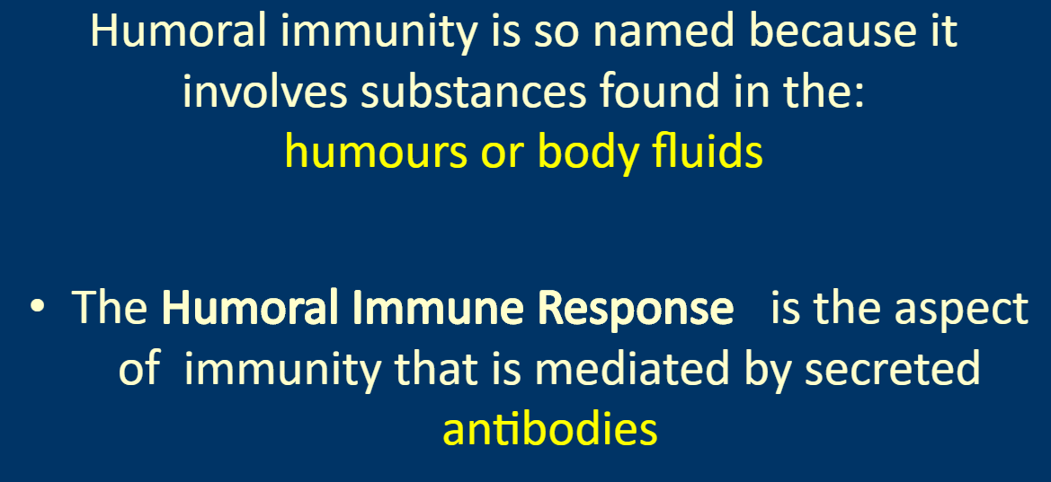

Slide 5
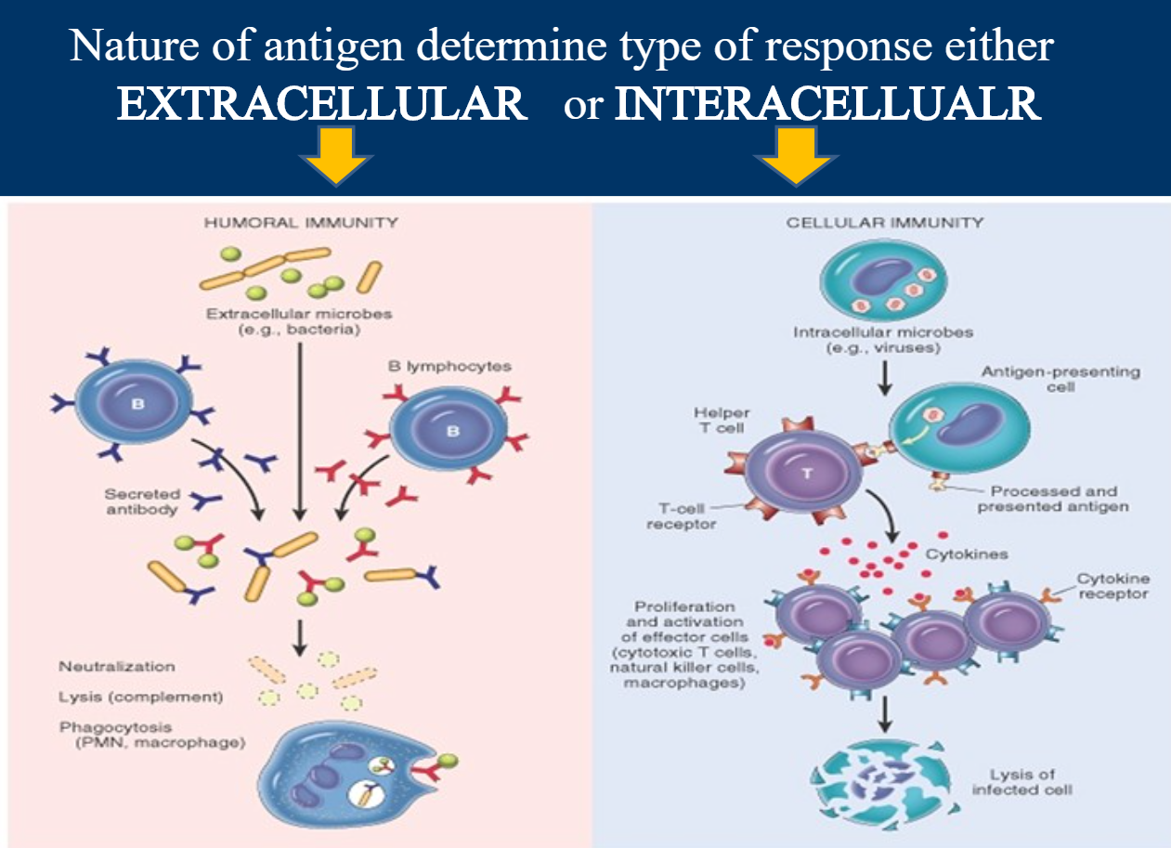
c

Slide 6
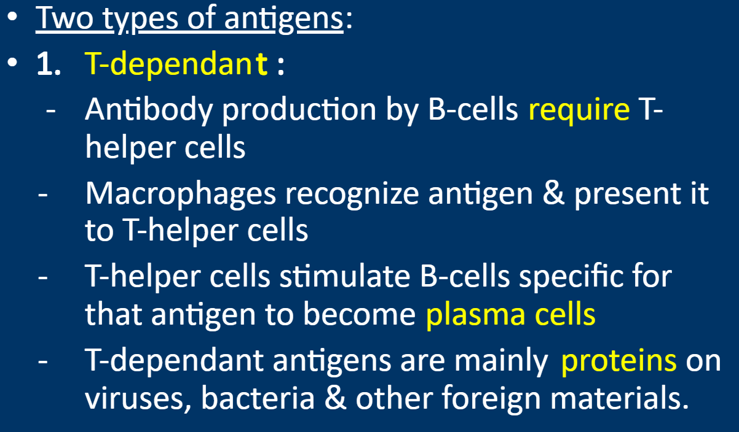
Activation of B cells by antigens

Slide 7
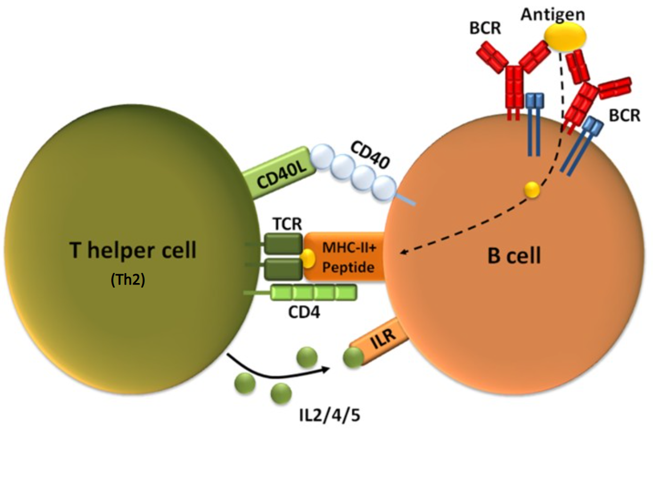
c

Slide 8
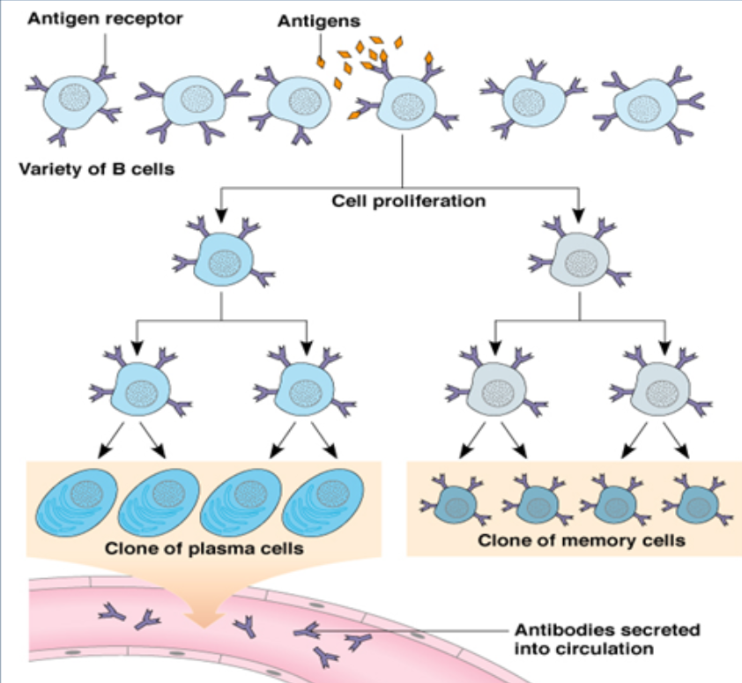
Clonal selection and clonal proliferation

Slide 9
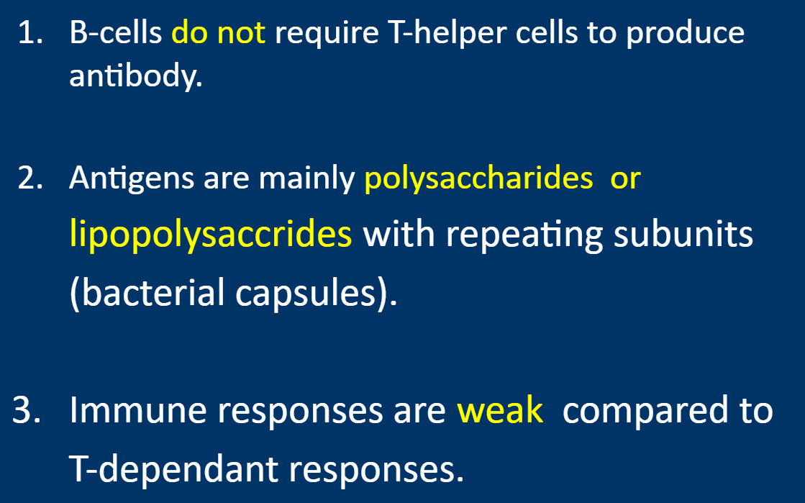
T-independent antigens

Slide 10
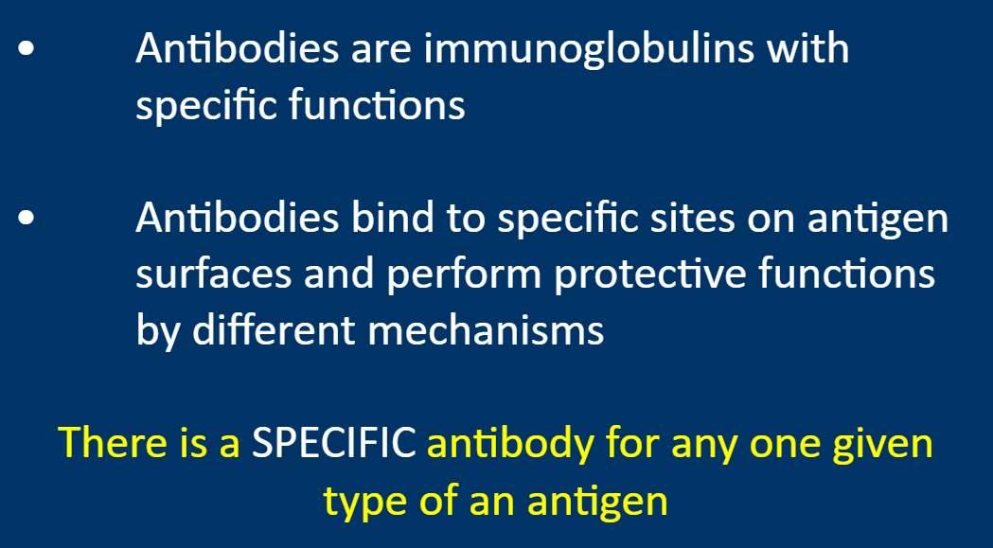
Antibodies

Slide 11
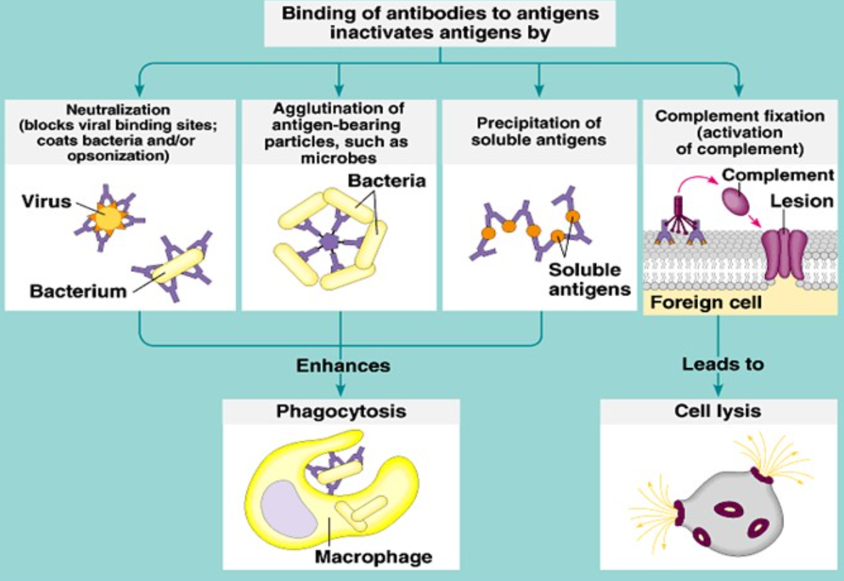
Protective functions of antibodies

Slide 12
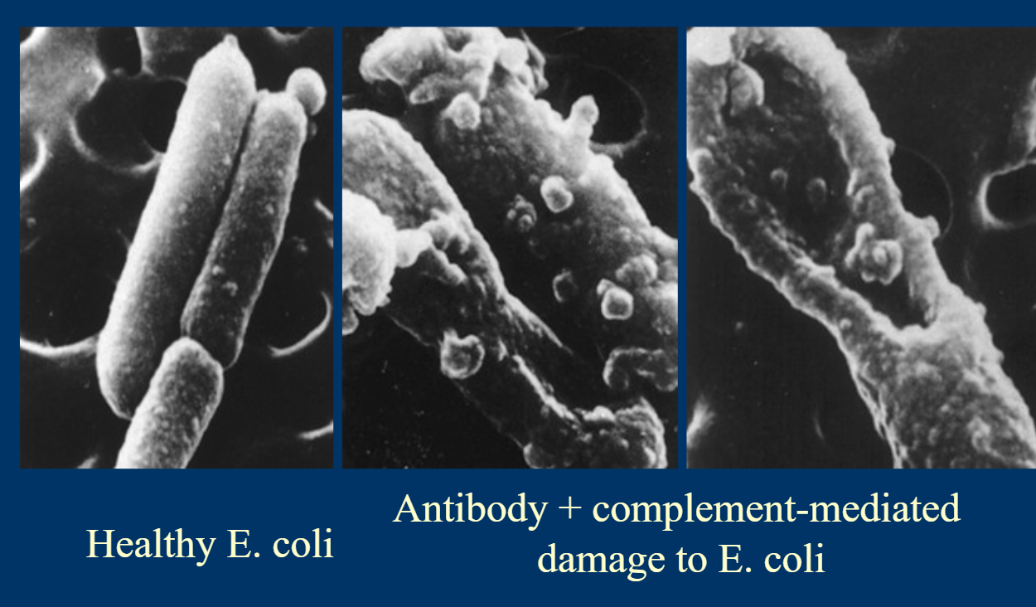
Electron micrographs of the effect of antibodies and complement upon bacteria

Slide 13
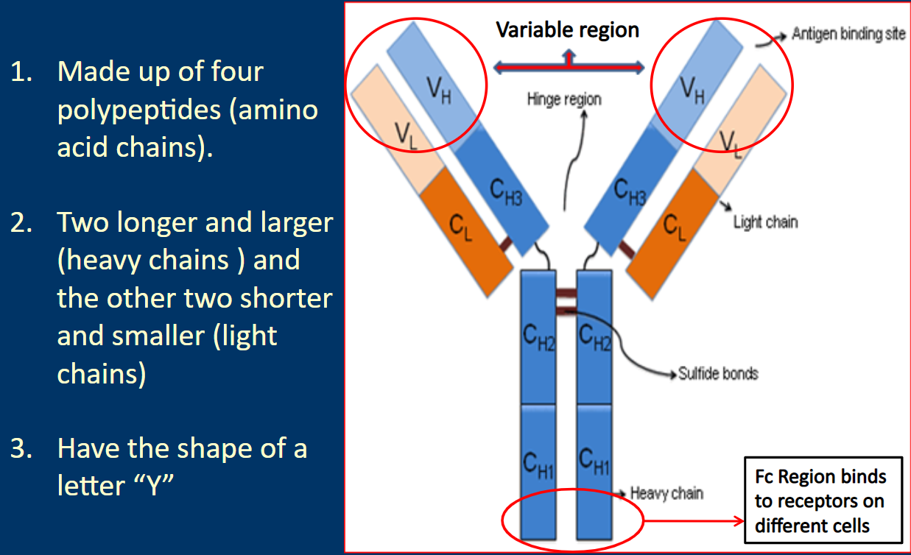
Antibody structure and functions

Slide 14
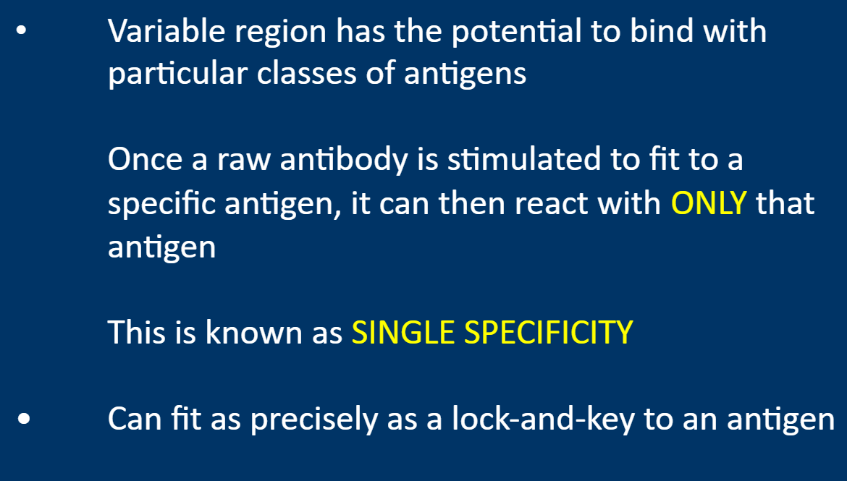
c

Slide 15
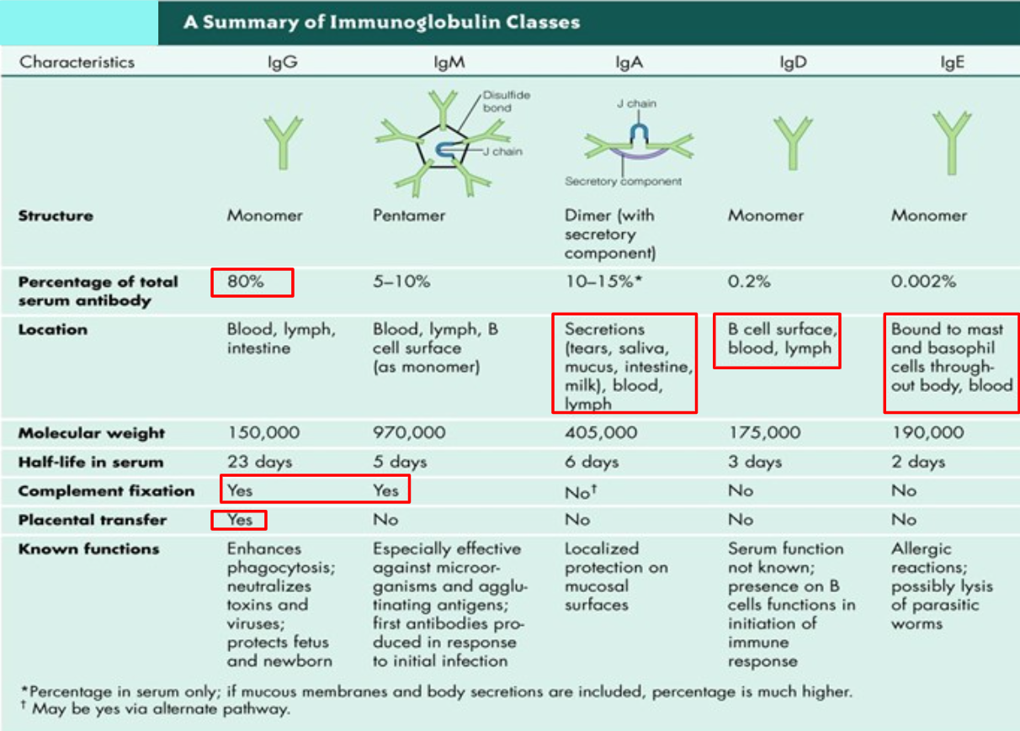
c

Slide 16
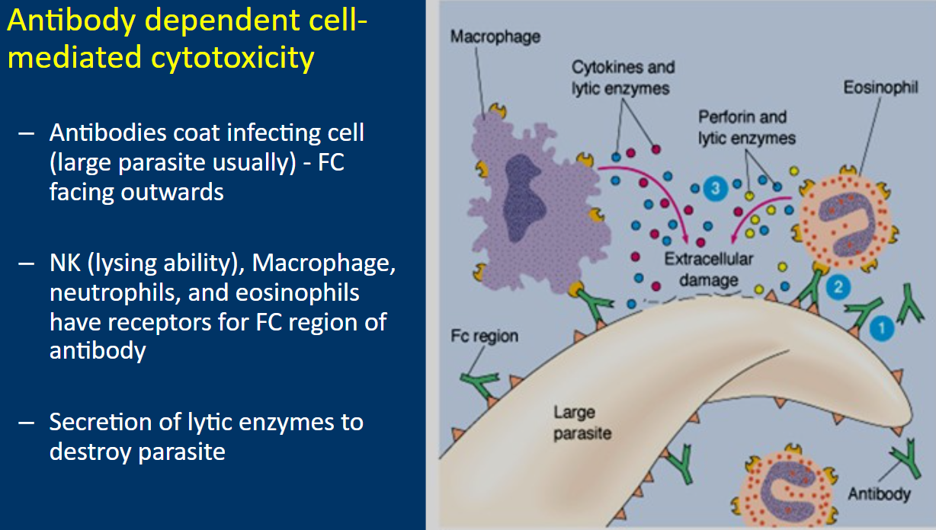
Functions of Antibodies

Slide 17
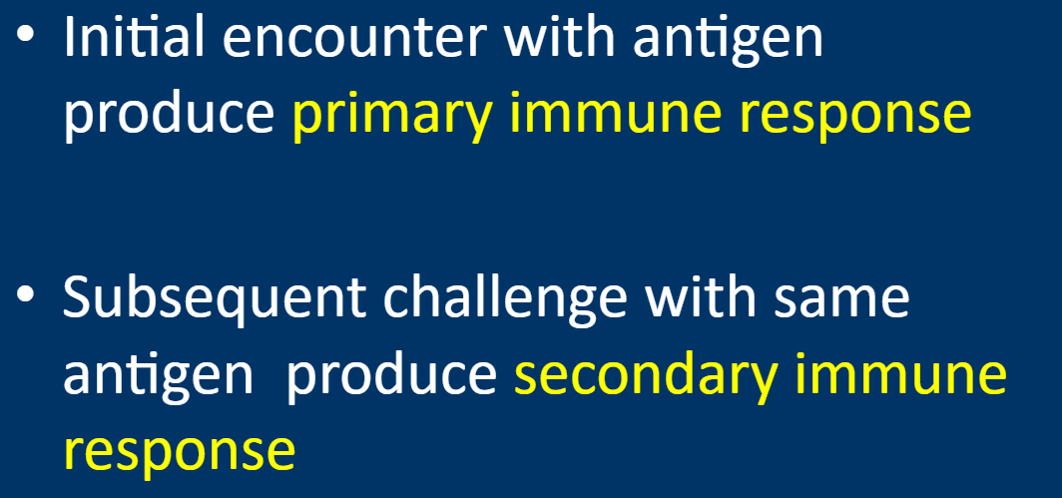
Primary & Secondary immune responses

Slide 18
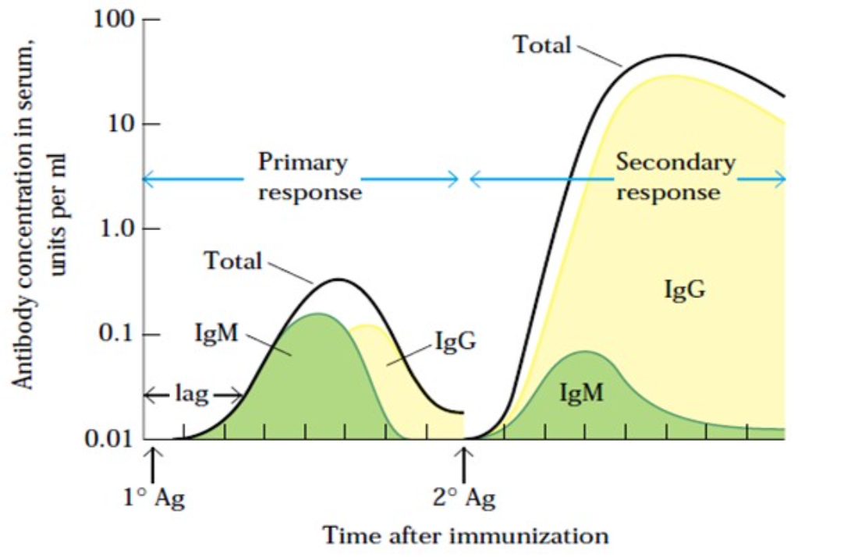
Concentration & type of antibody in primary & secondary immune responses

Slide 19
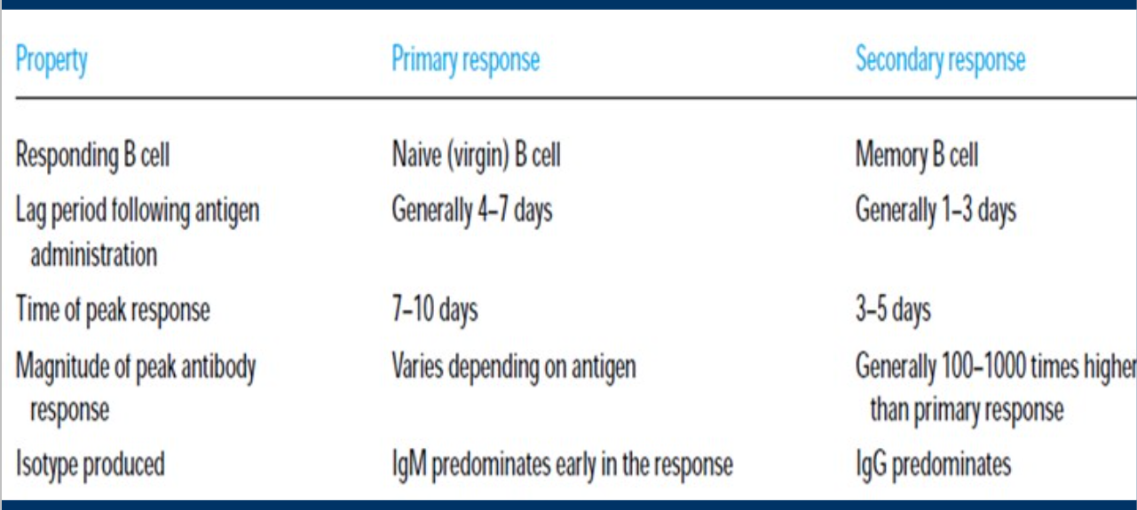
Comparison between primary and secondary responses

Slide 20
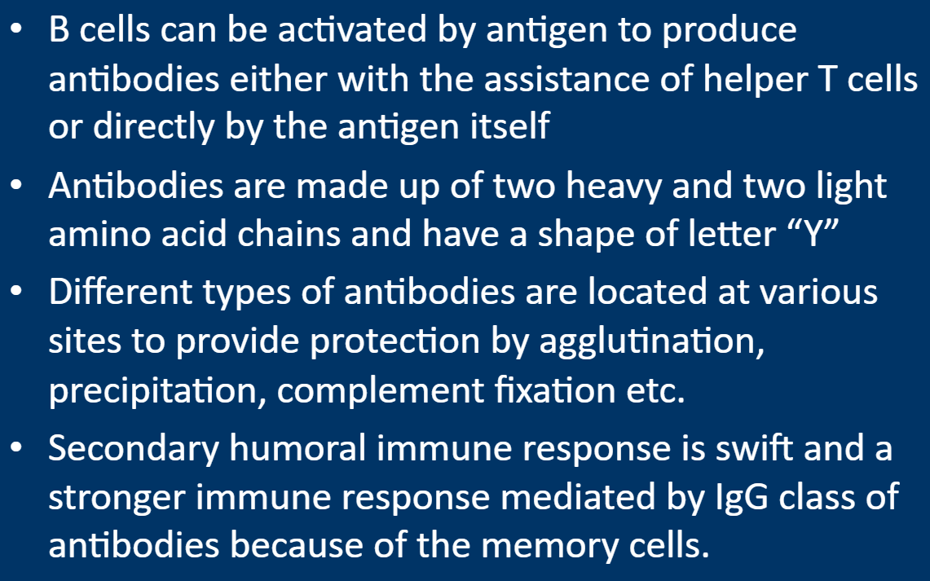
Summary:

Slide 21
Source:
https://player.slideplayer.com/14/4447058/#

