Slide 1

System for Transformation and awareness
By i-HEALTH

Slide 2
Transformation and awareness
PsyChi offers a new concept for the effective release of negative core beliefs .
Therapy resistance it is often called but behind these there are deeply ingrained emotions that have become your patients realities.
These negative core beliefs make your patients suffer and they are so strong that the self healing capacities of the body are being blocked.
PsyChi is easy to learn, profound and very effective. It opens the realm of the psyche to be released effectively by …… you or your assistent.
PsyChi

Slide 3
Age old tradition infused with new life
PsyChi
  A combination of age old, traditional healing knowledge of TCM, brought to new life thanks to visionary Julia Workman
  A combination that can be shared with many, thanks to new technology
  Blocked Emotions come to life and can be released with the speed of light….
  Integration of new realities that replace old ones with the help of natural and subtle energies

Slide 4
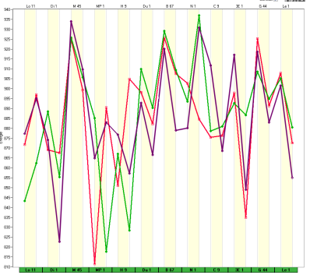
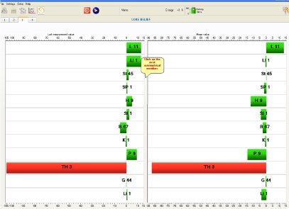
The meridian network shows it all !
The meridian network reveals it all !
Step 1: Revelation and discovery.
  Easy to learn, accurate measurements reveal the patient’s emotional theme
  With the help of frequencies the emotions are explored by the patient in a very gentle, profound process.
Step 2: Elimination
  The meridian-network receives light-frequencies with which the negative memories are eliminated with the speed of light.
Step 3: Integration
  Thanks to the elimination there is space for a new awareness, a new reality. Supported by frequencies, the meridian-network is used to integrate the new reality
PsyChi

Slide 5

Transformation and awareness
Video 1: A wake up call to make you aware that there is a huge untapped potential in your practice for helping people
Video 2: How the mind works and how it often prevents us to process emotions effectively
Video 3: Explanation of the system and of how emotions are influencing our body, as depicted at the meridian network
Video 4: a demonstration of psychi in practice
psychi

Slide 6
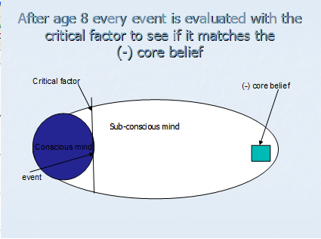
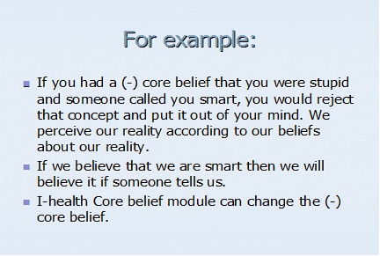
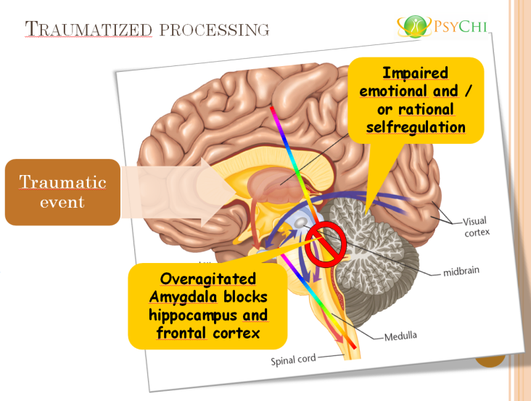
From Traumatic event to blocked meridians
It is only a few steps from the theory of the mind to the meridian network. Let me repeat briefly …..
Traumatic event
Amygdala is
Excessively
Agitated
And
Blocks
Further Processing
By Hippocampus
And
Frontal cortex.
After the traumatic event, reality is distorted, so emotional processing is traumatized.

Slide 7
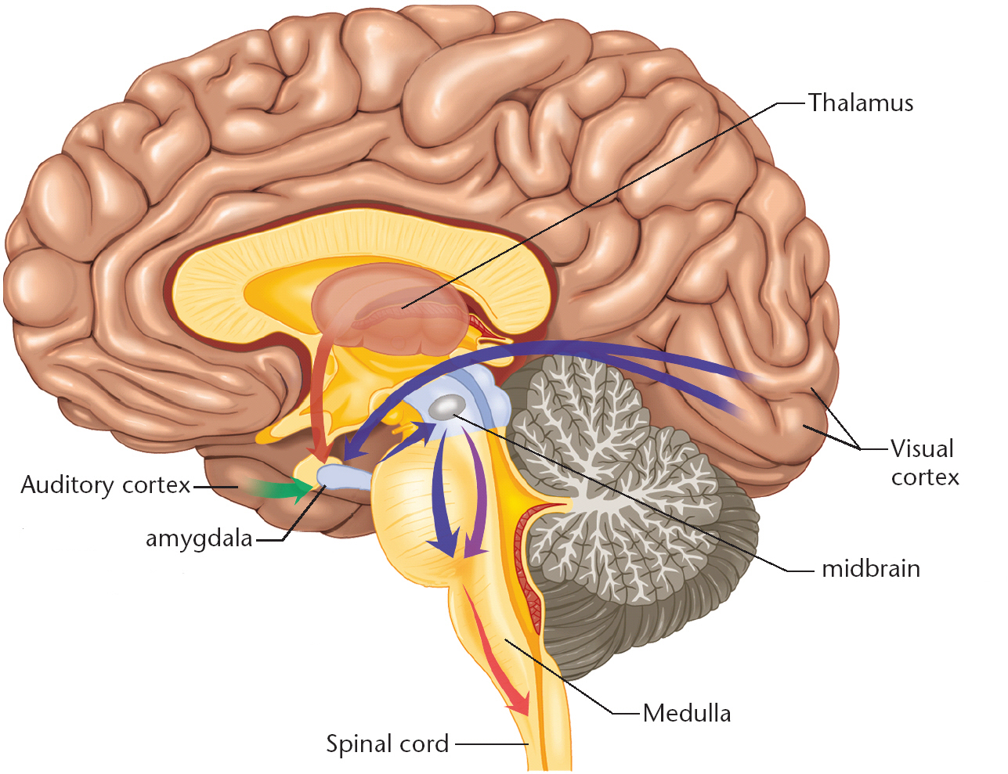
Traumatized processing
Impaired emotional and / or rational selfregulation
Traumatic event
7
Overagitated Amygdala blocks hippocampus and frontal cortex
Notes:
7
Het emotionele brein is in staat het rationele brein uit te schakelen. Als gevolg van zware stress reageert de voorhoofdskwab niet meer (gaat off-line) en verliest het vermogen het gedrag te sturen. Direct nemen reflexen en instinctief handelen de zaak over.
Ook paniekaanvallen hebben een dergelijk verloop. Het slachtoffer, die bijvoorbeeld de indruk heeft dat hij een hartinfarct krijgt, heeft alle lichamelijk verschijnselen daarvan. Het emotionele brein neemt de controle van alle lichaamsfuncties over, het hart slaat op hol, de buik zit in de knoop, de handen trillen, het angstzweet breekt uit. Tegelijkertijd wordt het rationele brein uitgeschakeld door een adrenalinestoot. Ook al ziet het rationele brein geen reden tot paniek, het kan niets doen zolang het “off-line” staat.

Slide 8
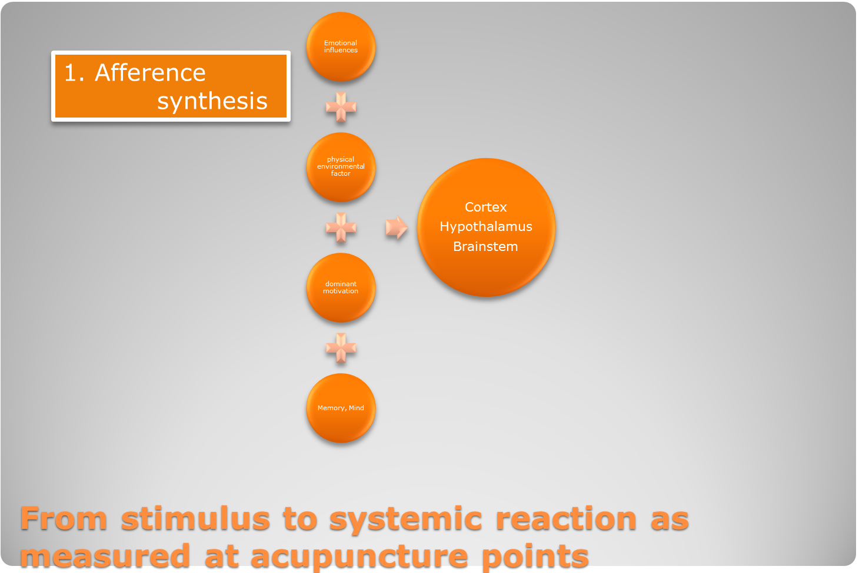
Blocked emotional processing influences systems down the line ………

Slide 9
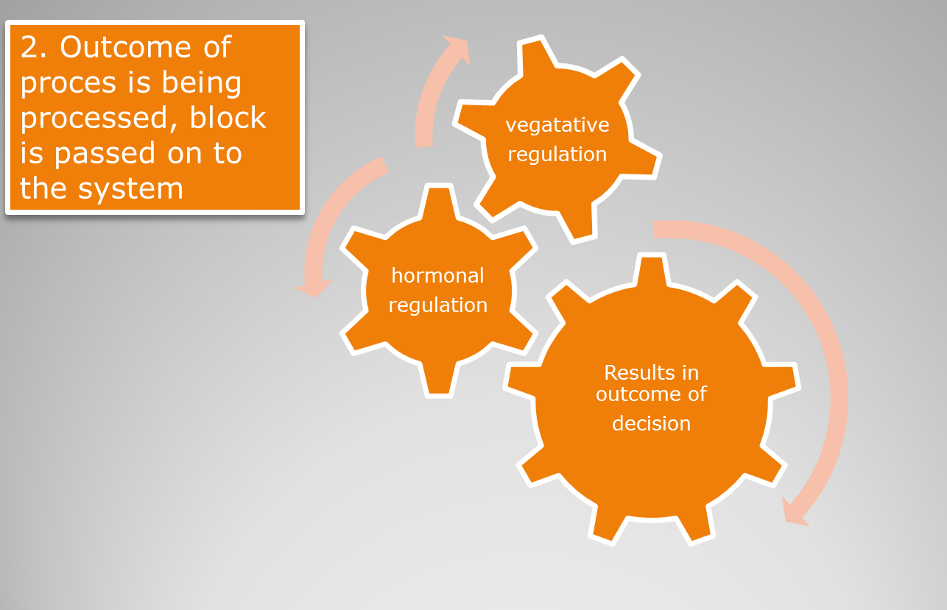
Where it is passed on ……and on …..

Slide 10
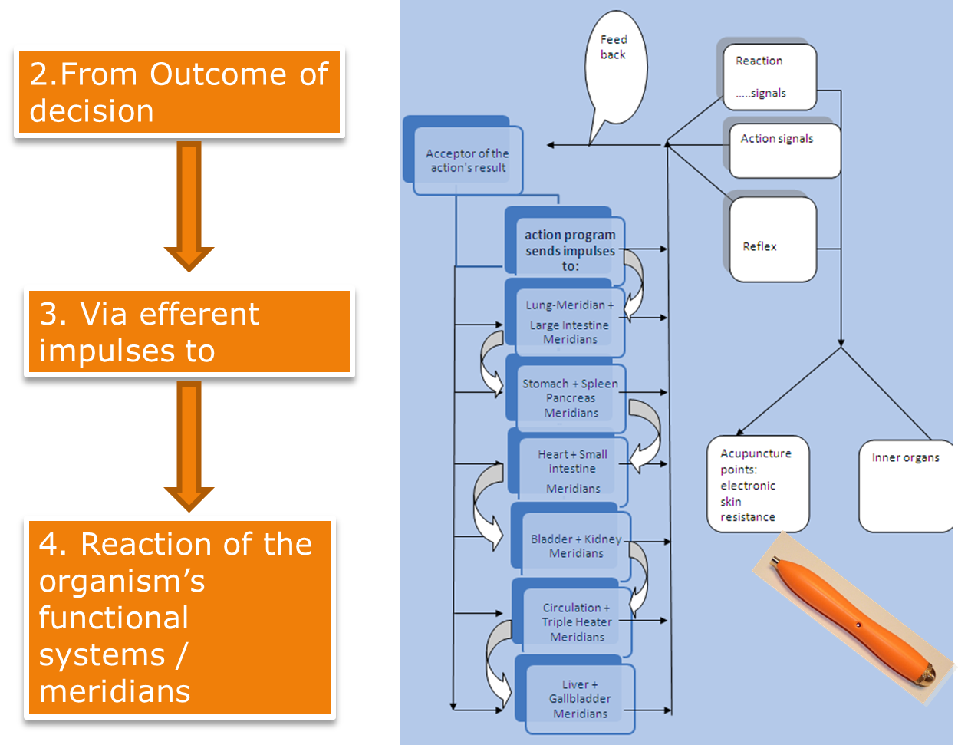
…passed on …
…to the meridians

Slide 11
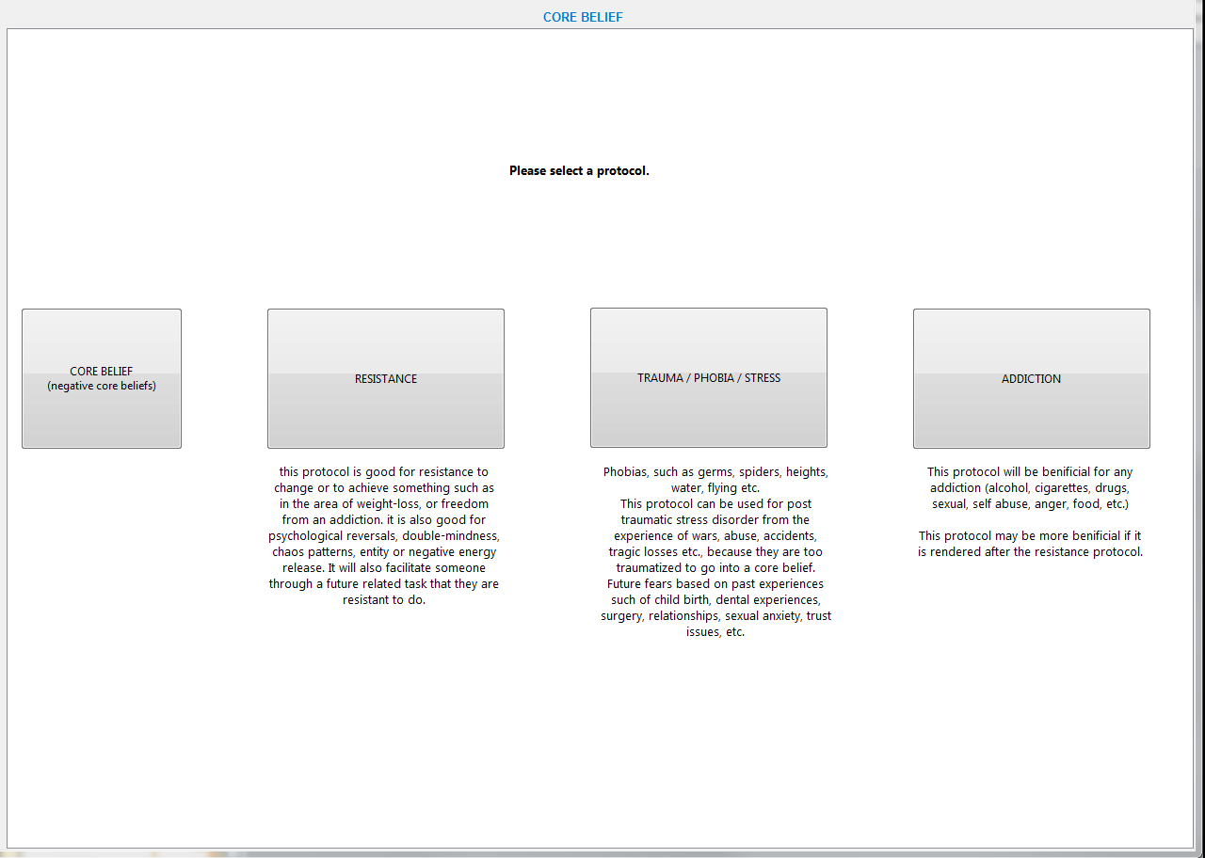

Slide 12
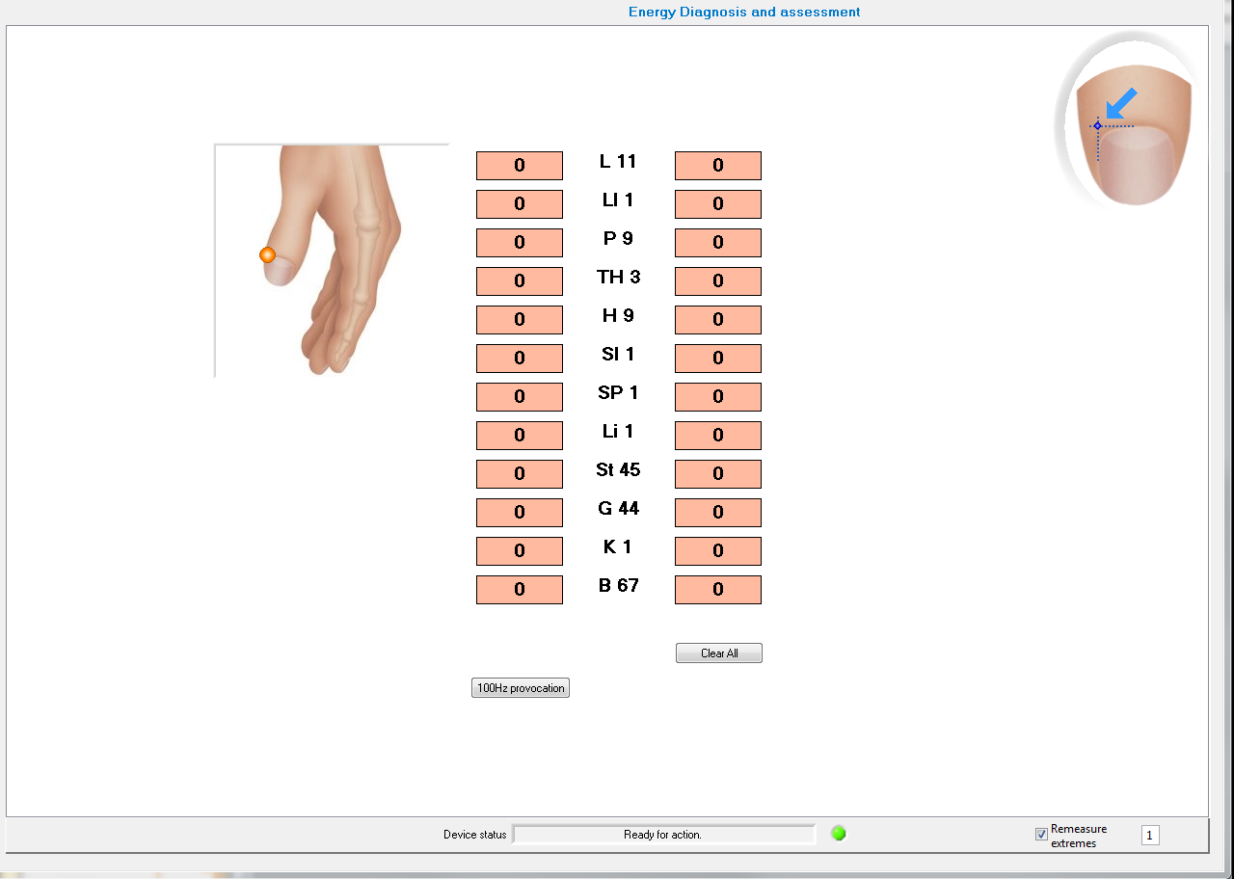

Slide 13
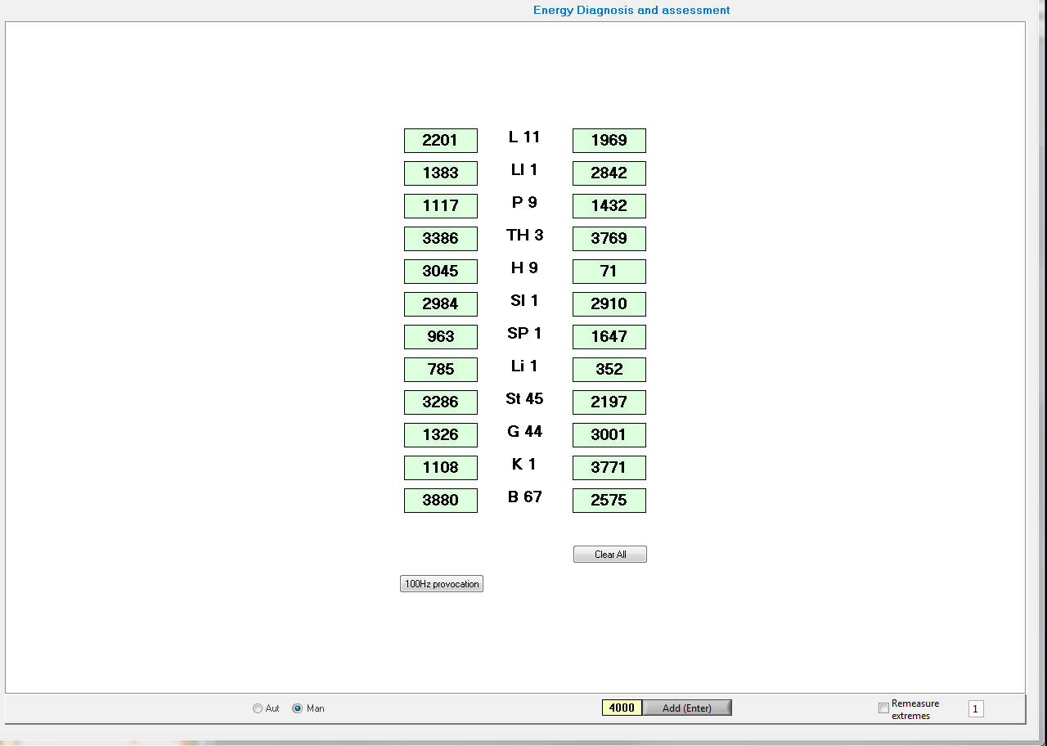

Slide 14
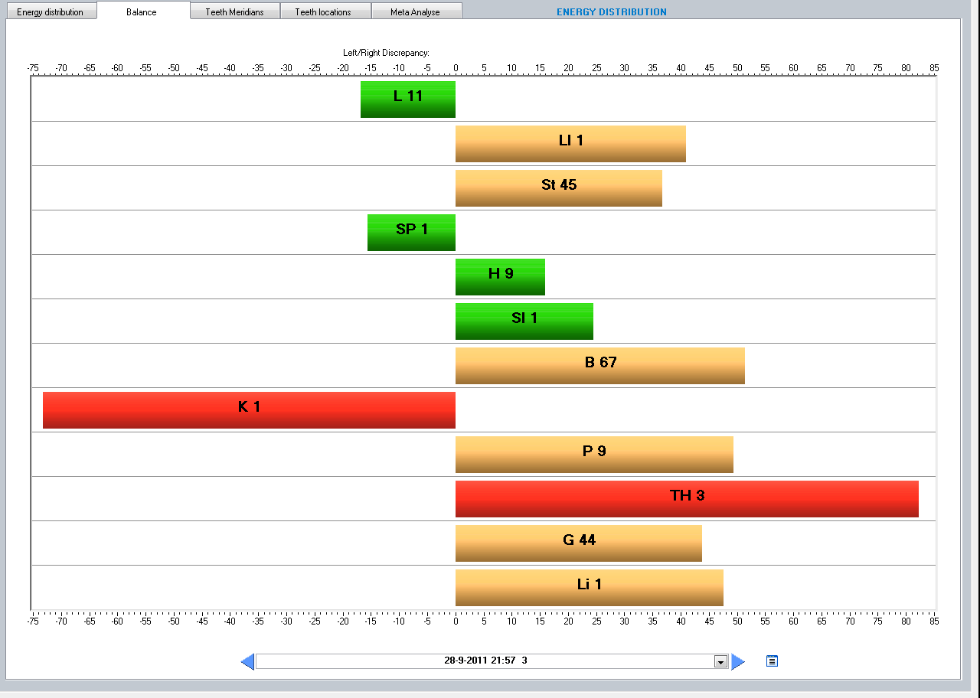

Slide 15
Each meridian has its own emtional themes
The triple heater is the most unbalanced meridian and so has priority.
The emotional issues have to do with fear for social isolation

Slide 16
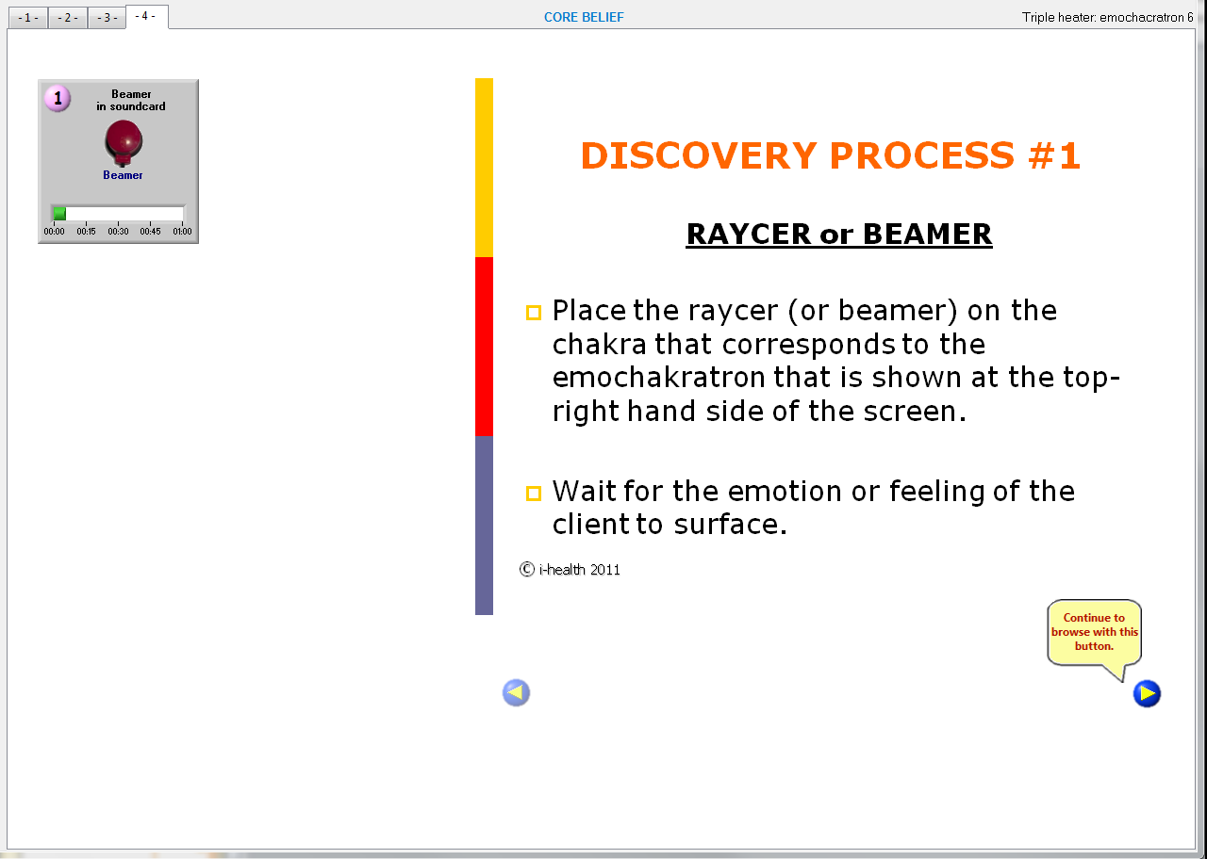

Slide 17
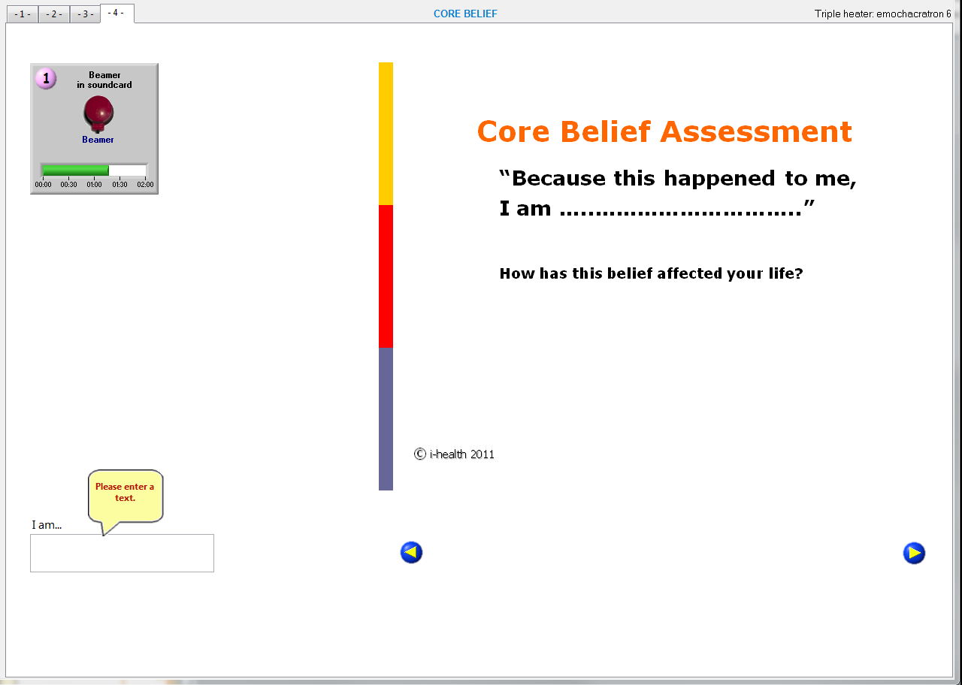
At the End of the discovery process, the client is able to
Formulate her – his -/- core belief

Slide 18
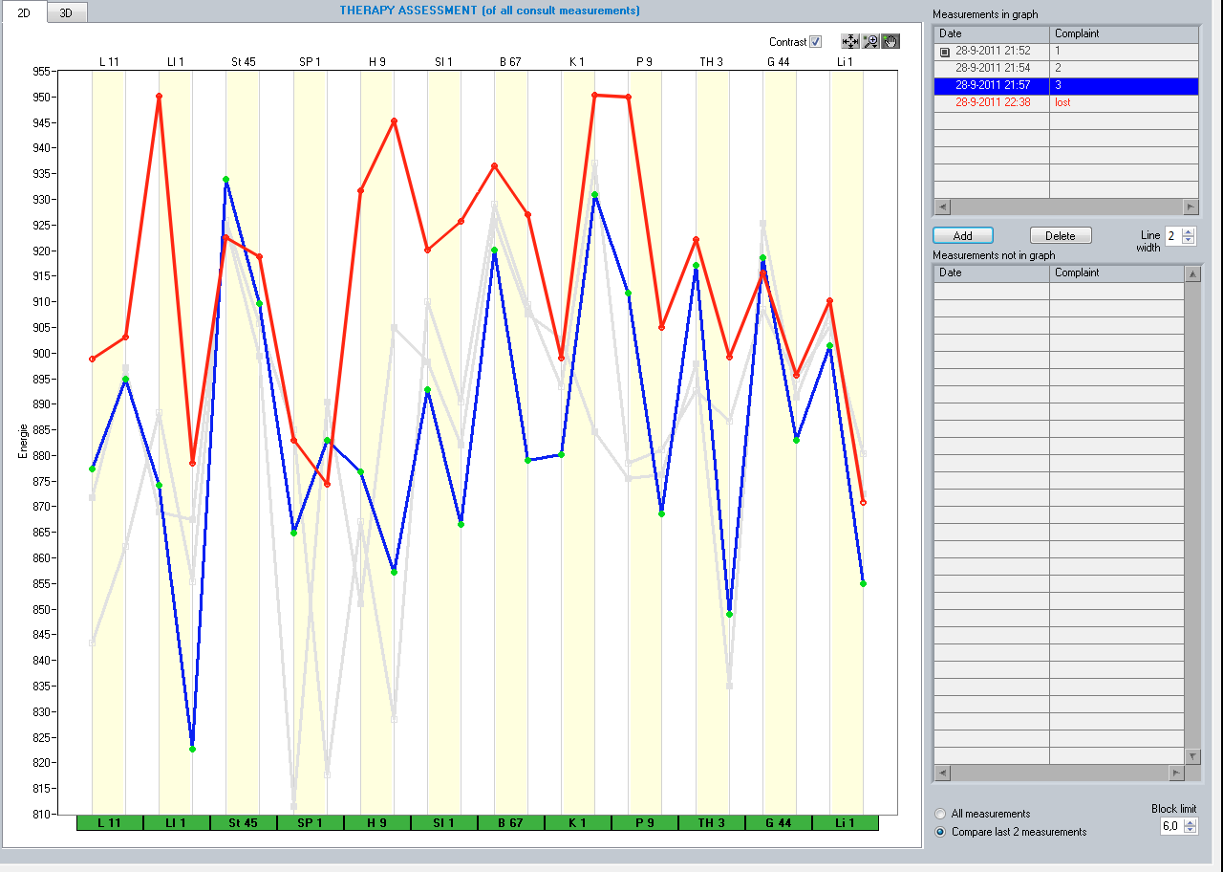
After session: Red Curve showing much more energy and balance, in particular of the TH meridian

